Slide 1
DESP:2000 - week 09
ADOBE PREMIERE – SHOWREEL
COMMENCE TECHNICAL DRAWING

Slide 2
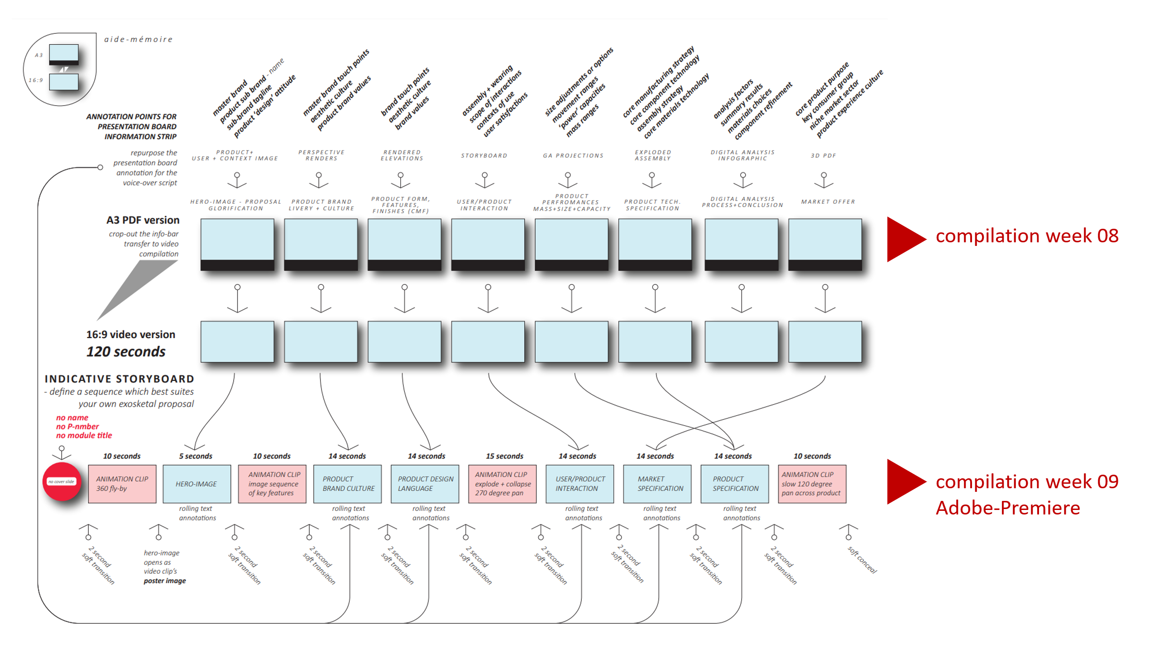
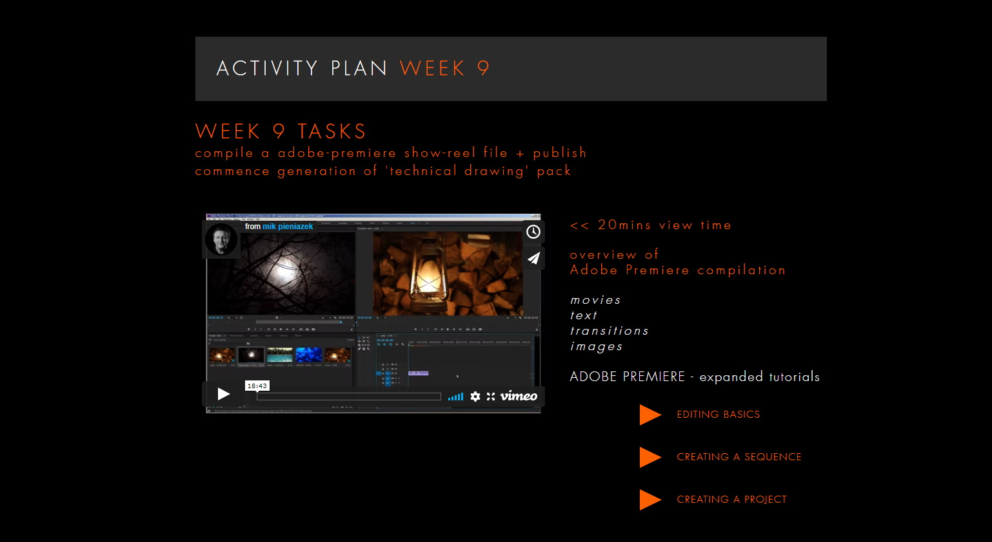
1920 X 1080 - landscape
EXISTING
PRESENTATION BOARD CONTENT
+ ANIMATIONS
animations
images
text
backplates
+ PERSONAL BRANDING
VIEW THIS >>
20 mins max
<< PLUS VIEW THESE – if you have time
+ CAD lab demonstration

Slide 3
COMMENCE TECHNICAL DRAWINGS
A0 SHEET SIZE – LANDSCAPE - COMMON TO ALL SHEETS
complete the following ‘drawing-sets’
at a recognised scale
        1:1 / 1:2 / 1:5 / 1:10 / 1:20 / 1:50etc
        include overall dimensions
        Include a title block
01:GA – front + side + isometric + iso-exploded + sections
02: SUB-ASSEMBLY – PELVIC ARMATURE – front + side + isometric + iso-exploded + sections
03: SUB-ASSEMBLY – UPPER ARMATURE – front + side + isometric + iso-exploded + sections
04: SUBS-ASSEMBLY – LOWER ARMATURE – front + side + isometric + iso-exploded + sections
COMPLIED AS A PDF PACK – ‘4 SHEETS’ in total

Slide 4
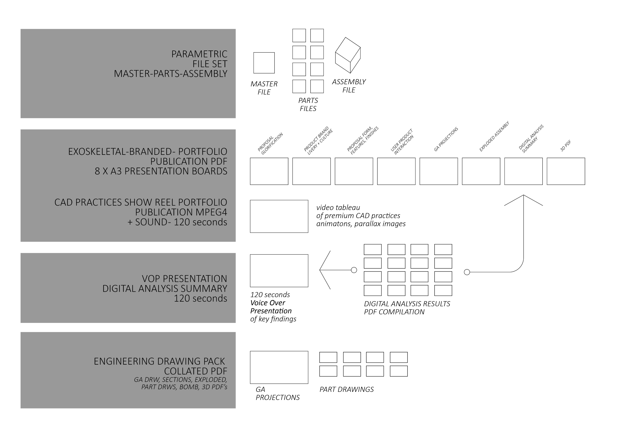
THIS IS NOT AN ASSESSMENT
SUBMISSION REQUIREMENT
WEEK 10
MODULAR CAD PRACTICES
PORTFOLIO PUBLICATIONS
4 portfolio pages
from both project 1 + 2
for each of the following ‘requirements’
Design for Usability
Design for Brand Culture
Design for Performance
Design for Manufacture

Slide 5
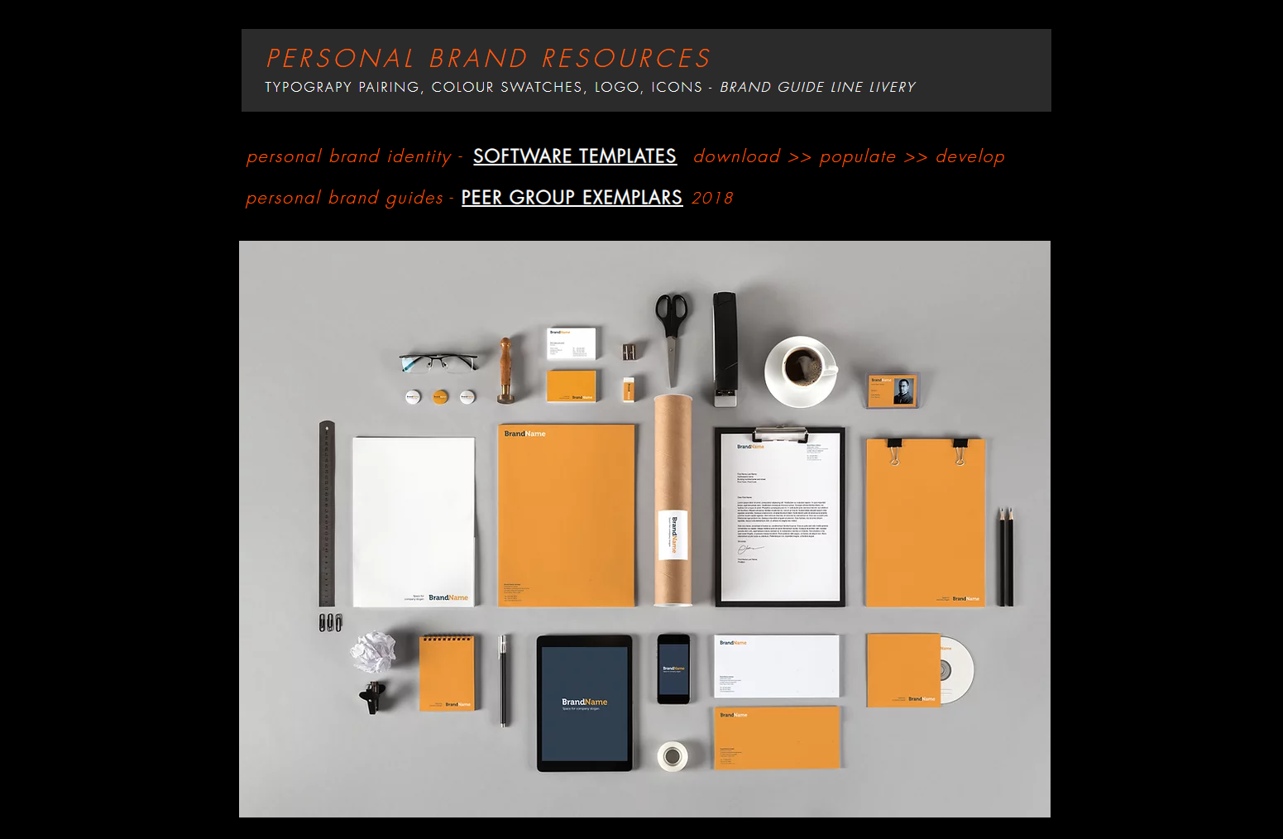

Slide 6
Q + A’s

