Slide 1
DESP:2000 PROJECT 2
EXOSKELETAL FORM - week 4

Slide 2
… what to have completed
in preparation for week 5
INTERNAL COMPONENTRY – representational
BODY WEBBING + PADDING
AMENDMENTS TO ENSURE FIT + ASSEMBLY
          WEEK 5
            SPLIT CASINGS + ADD ASSEMBLY FEATURES
            PART FILES + DRAFT ASSEMBLY
            EXPLODED ASSEMBLY
            GENERAL ASSEMBLY + SECTIONS DRAWINGS
            DRAFT ANIMATED-CAMERA VIDEO – 90 SECS

Slide 3
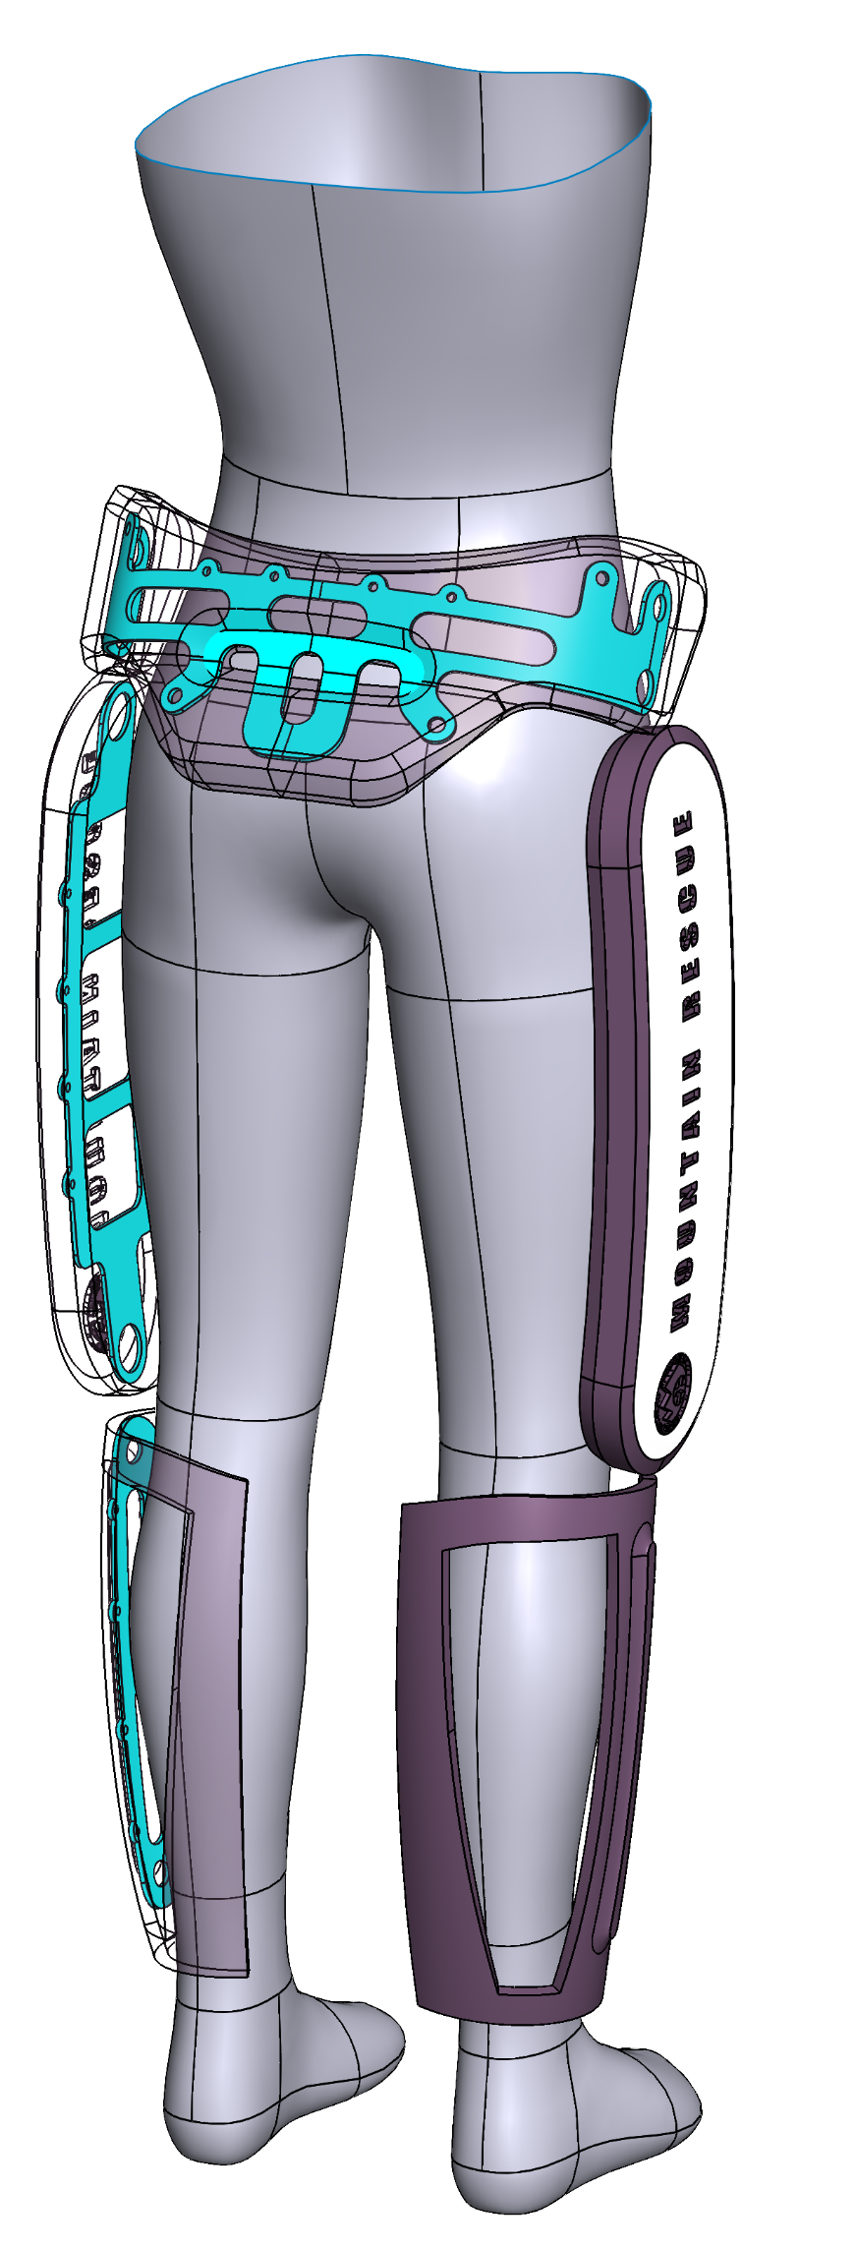
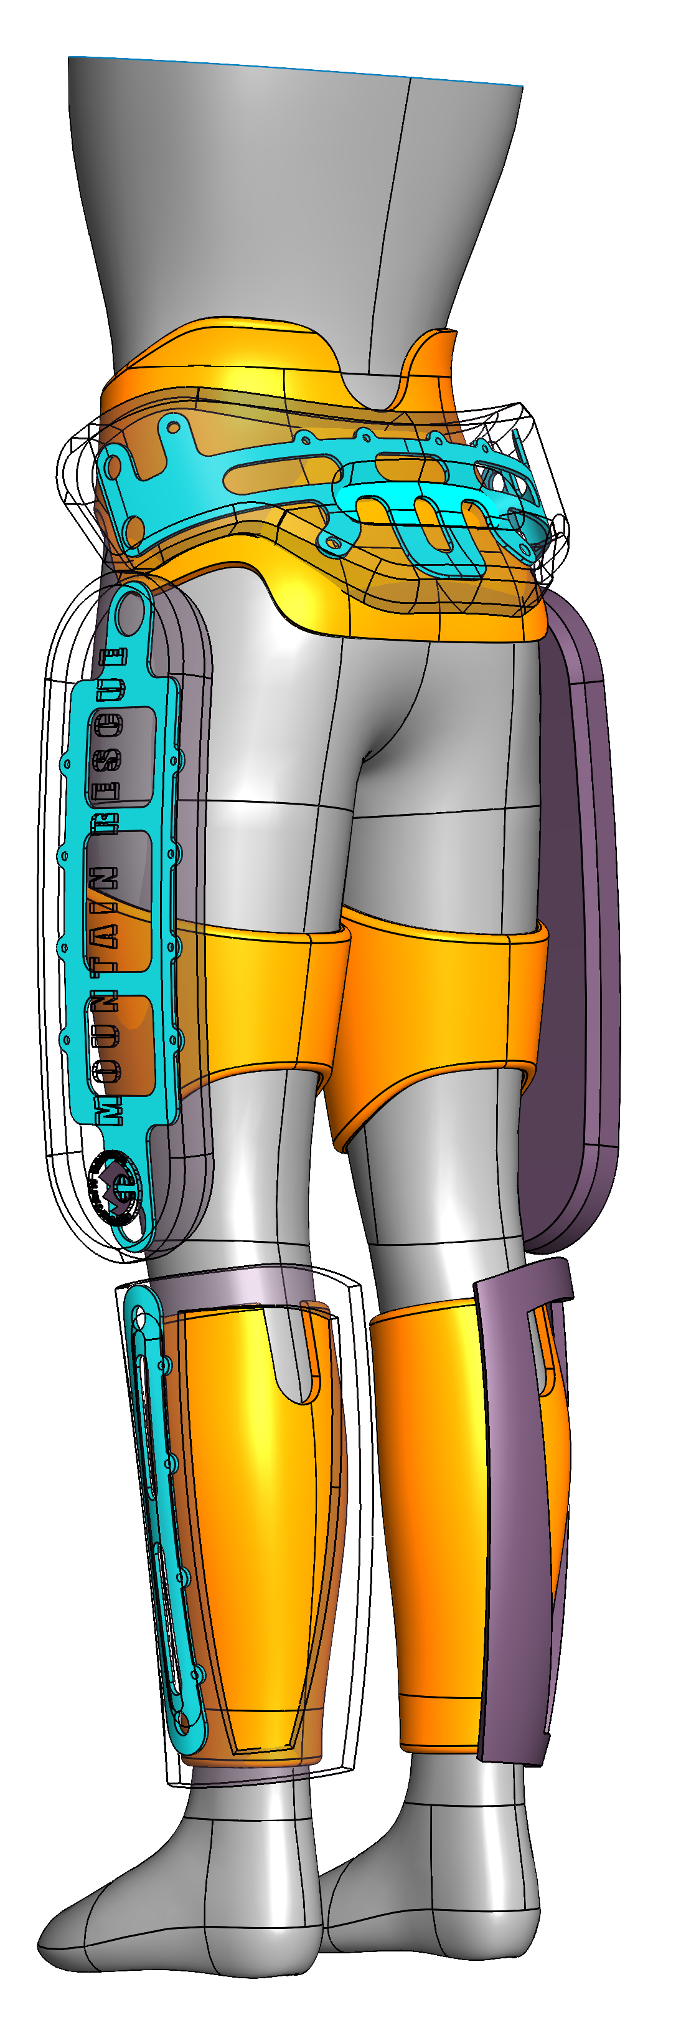
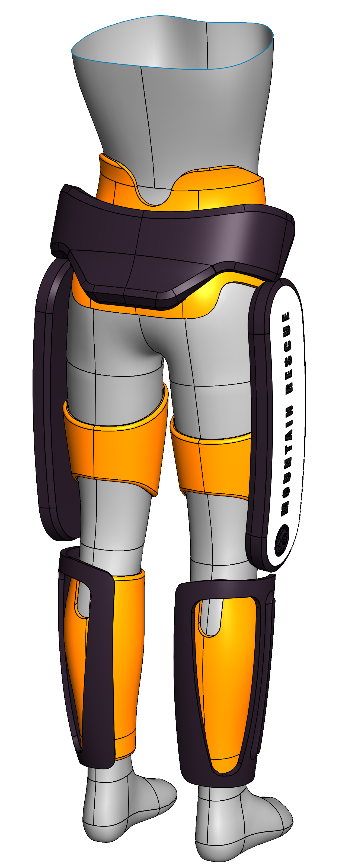
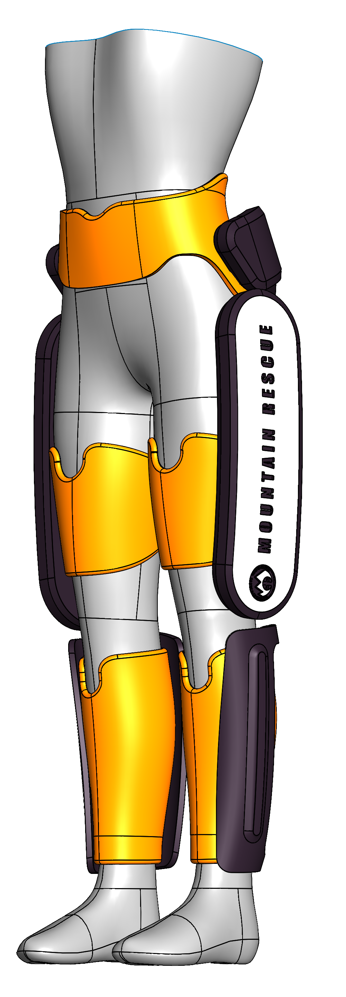
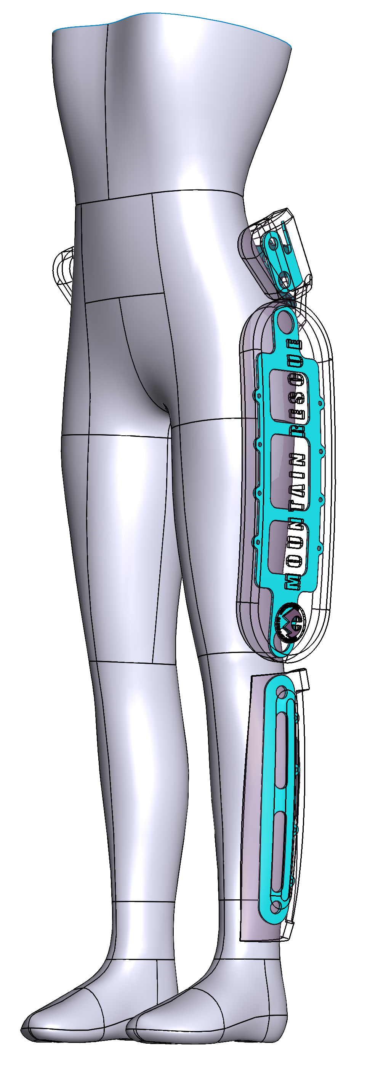
INTERNAL COMPONENTRY
BODY WEBBING + PADDING
CHECK + AMEND FIT

Slide 4
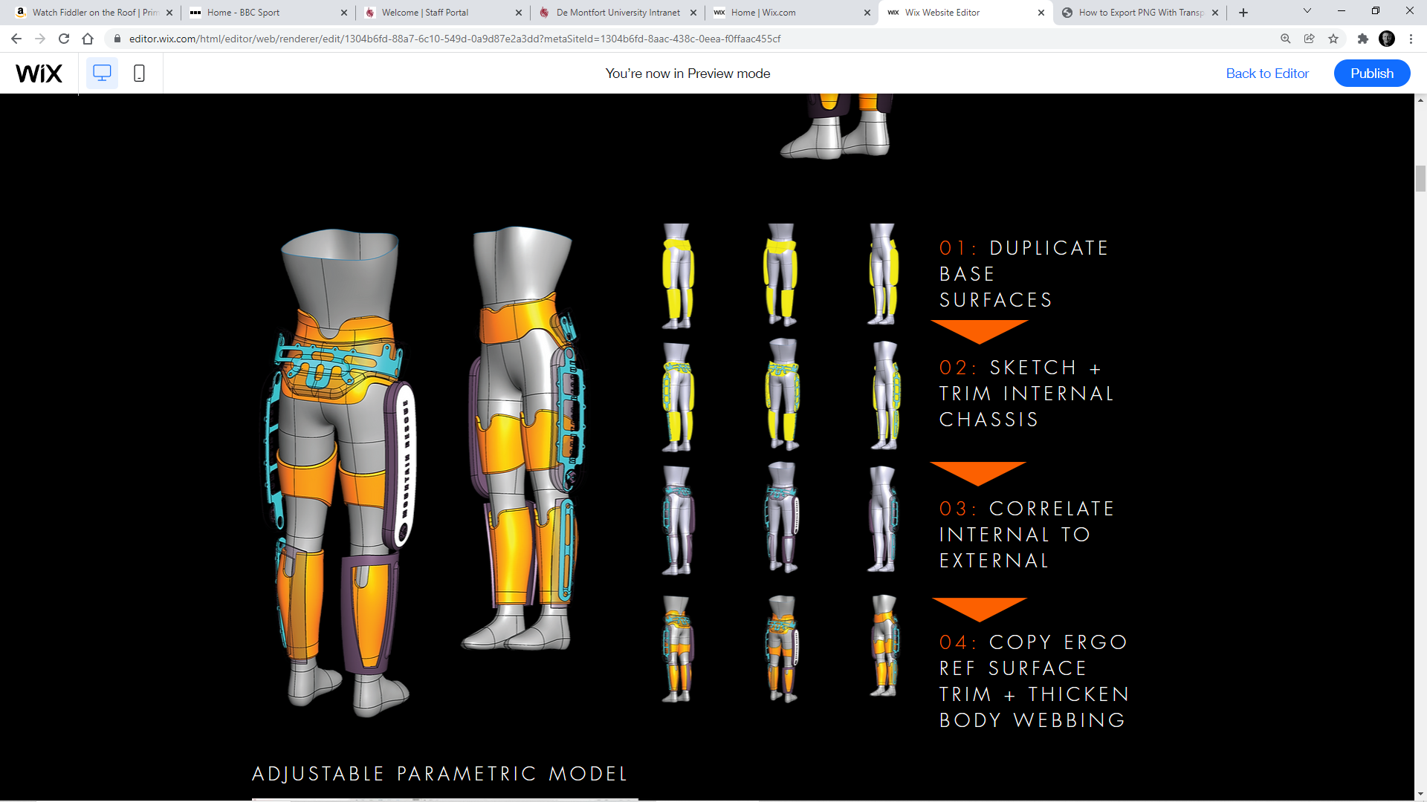

Slide 5
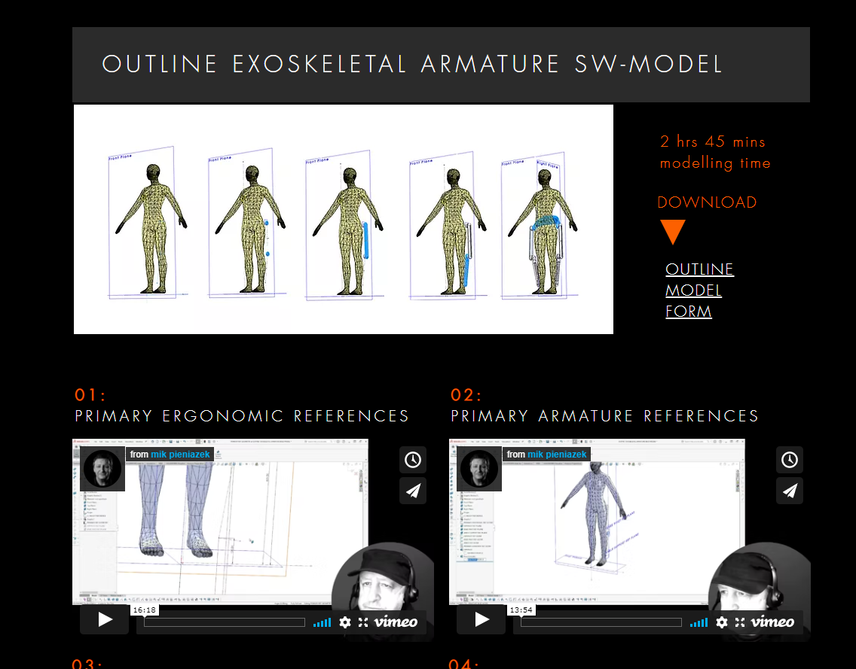
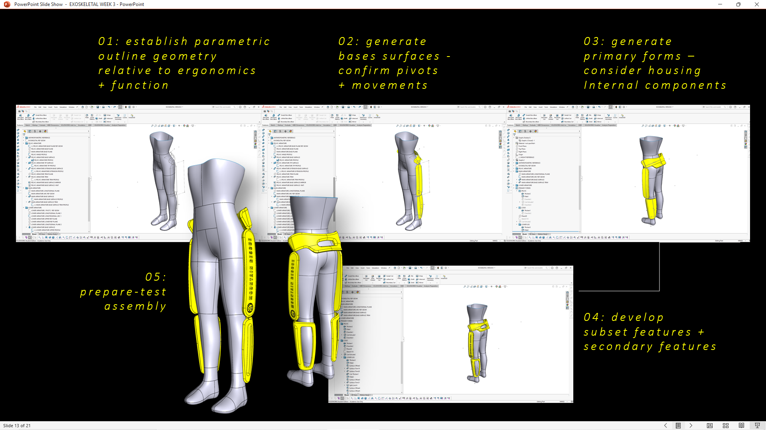
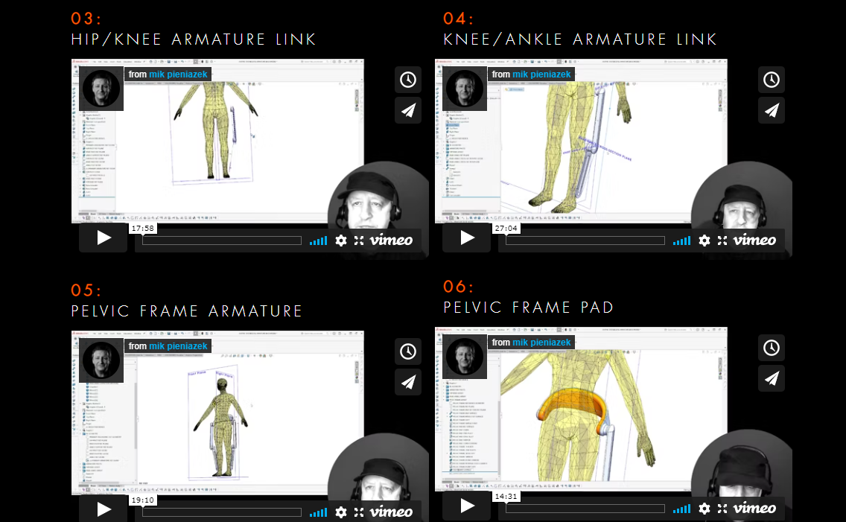
PARAMETRIC - adjustable - MODEL
WEEK 1
DRAFT MODELLING
EXERCISE
WEEK 2 – 3
MODELLING BASE SURFACE
PRIMARY FORM + FEATURES

Slide 6
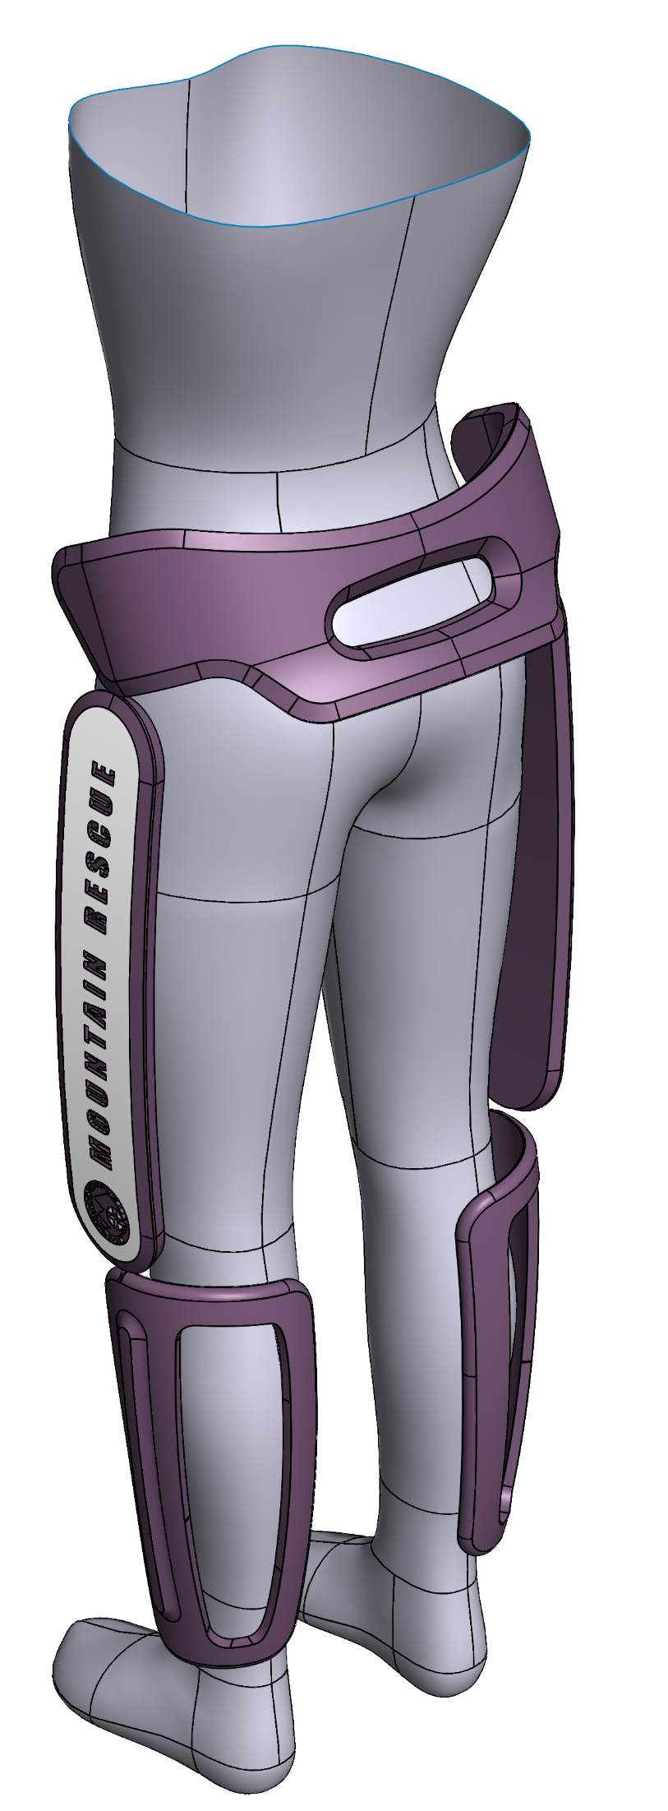
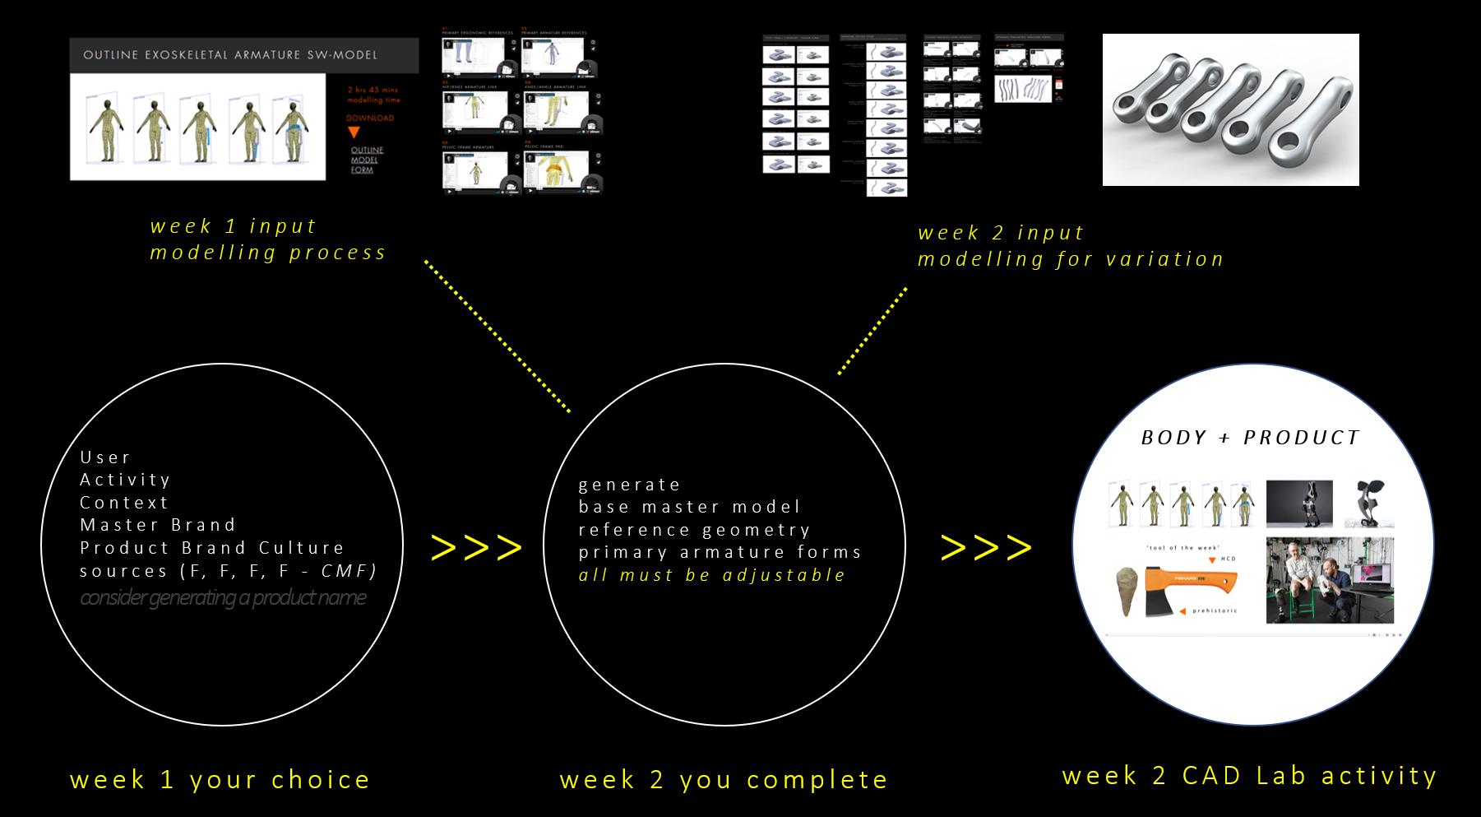


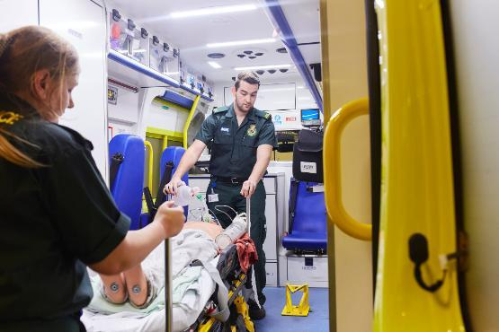
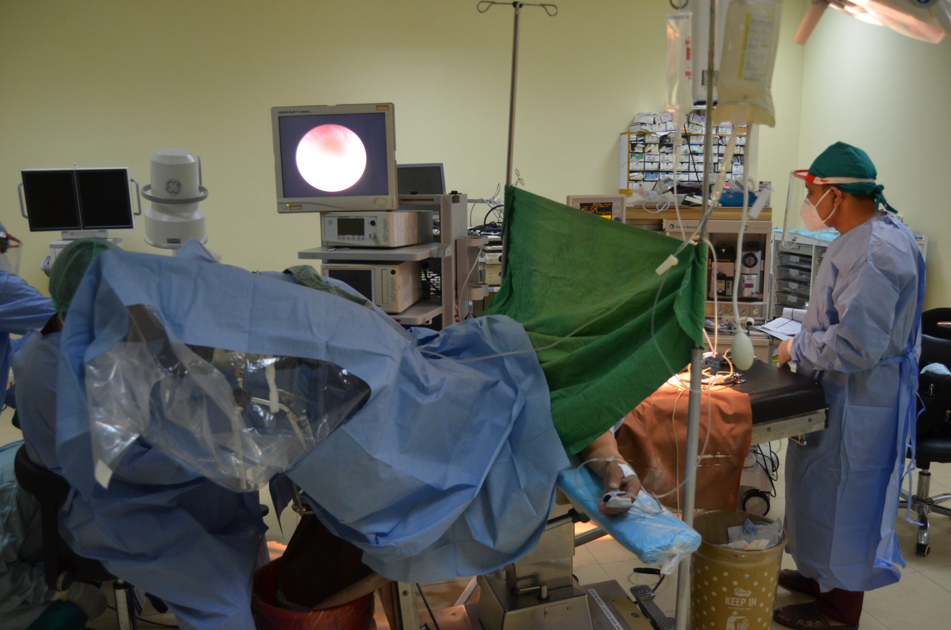
PROCESS TABLEAU – so far
40 hours– is this cost effective ?
to complete ready for the
beginning of week 5
week 1
week 2
week 3
week 4
user + master brand
design sources
trial modelling process
+ base surfaces + primary
subset-features +
secondary features + ergo ref
internal components
body webbing + padding

Slide 7
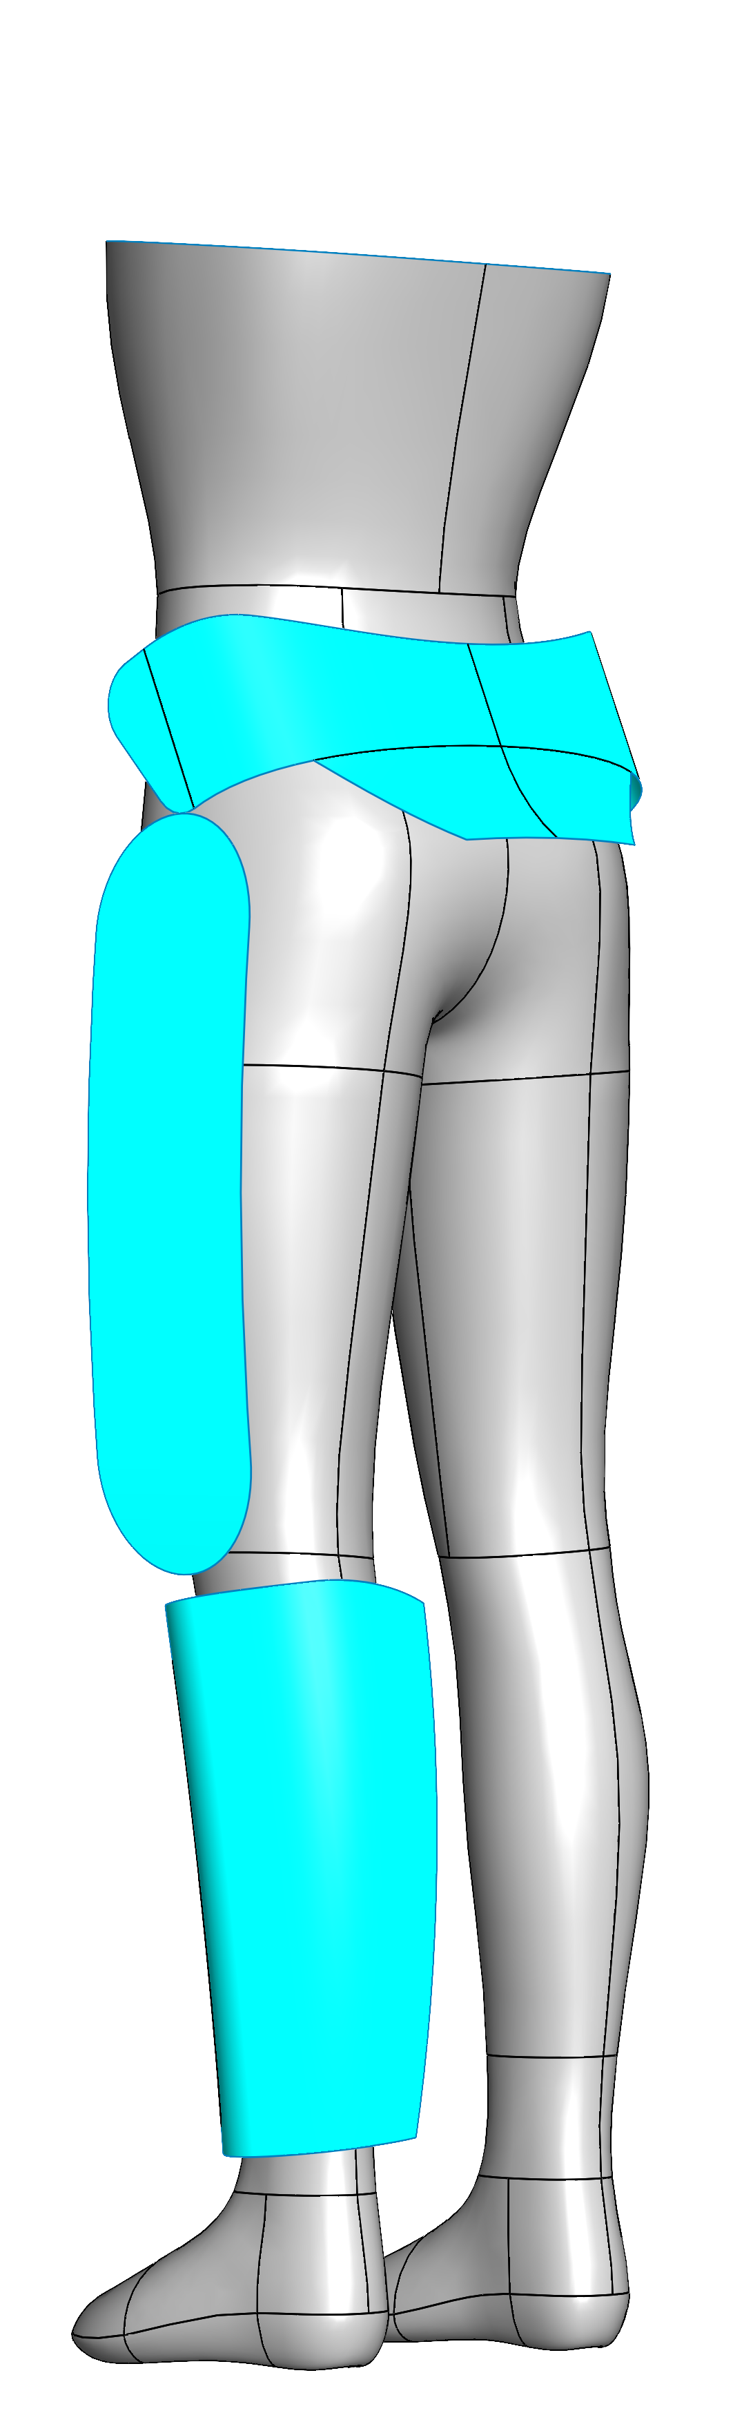
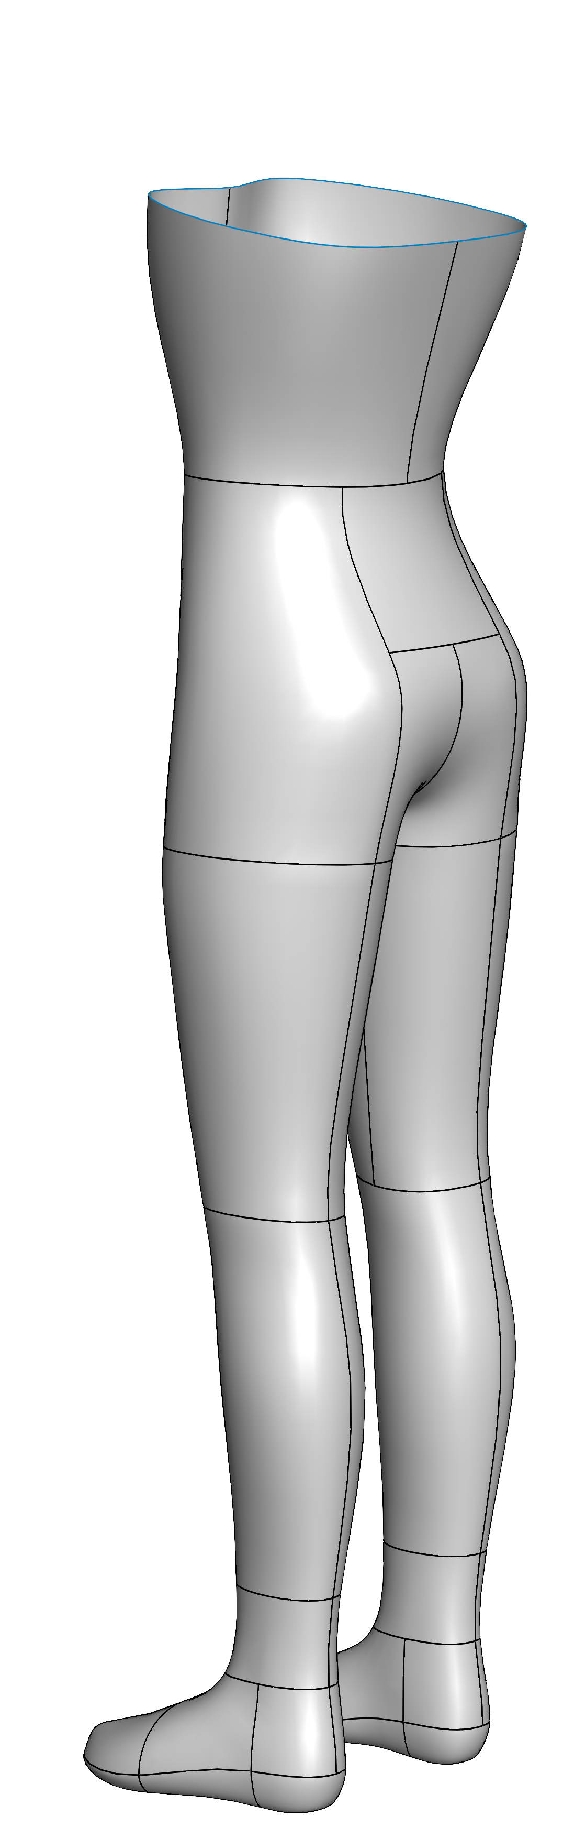
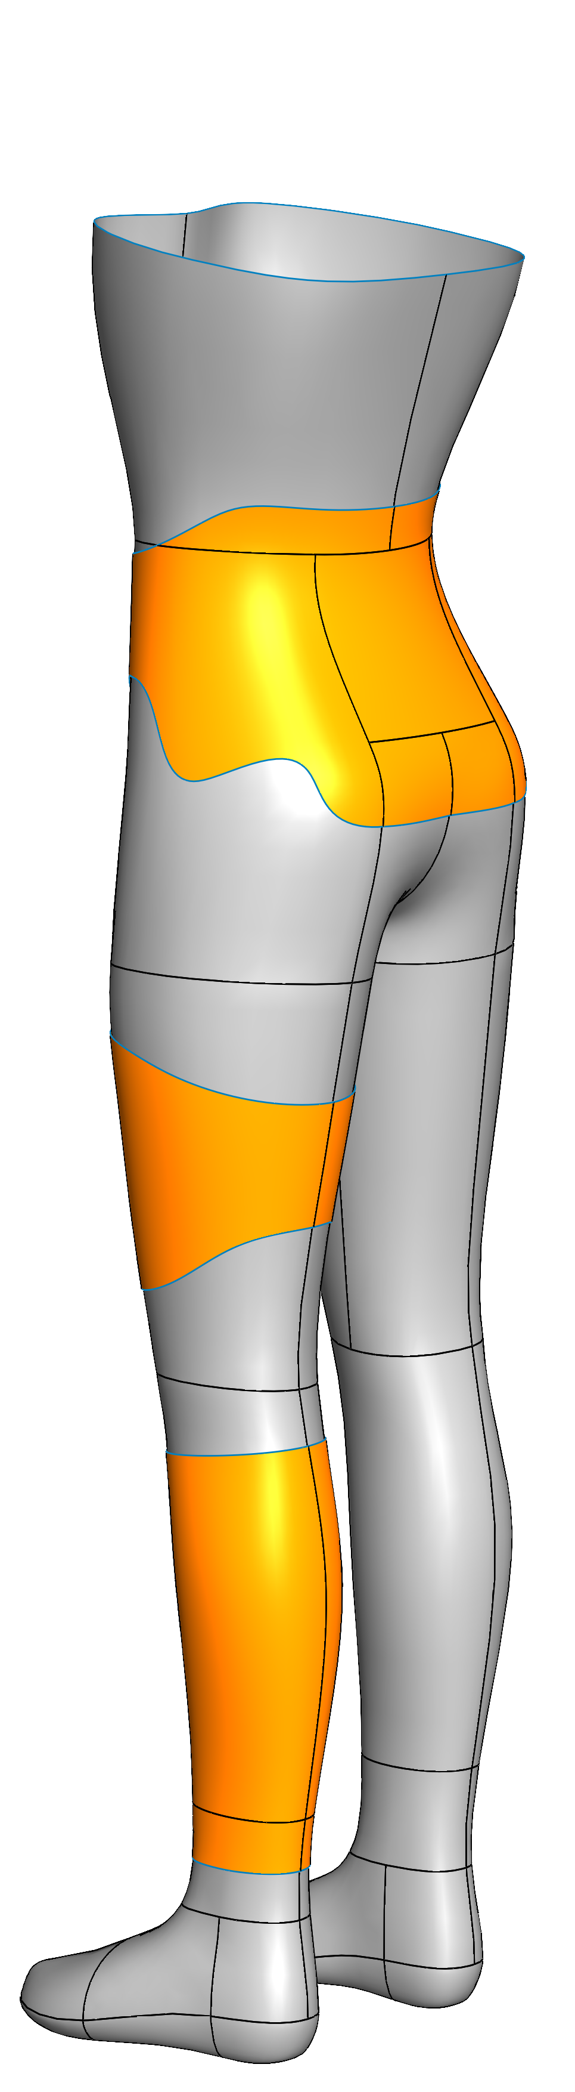
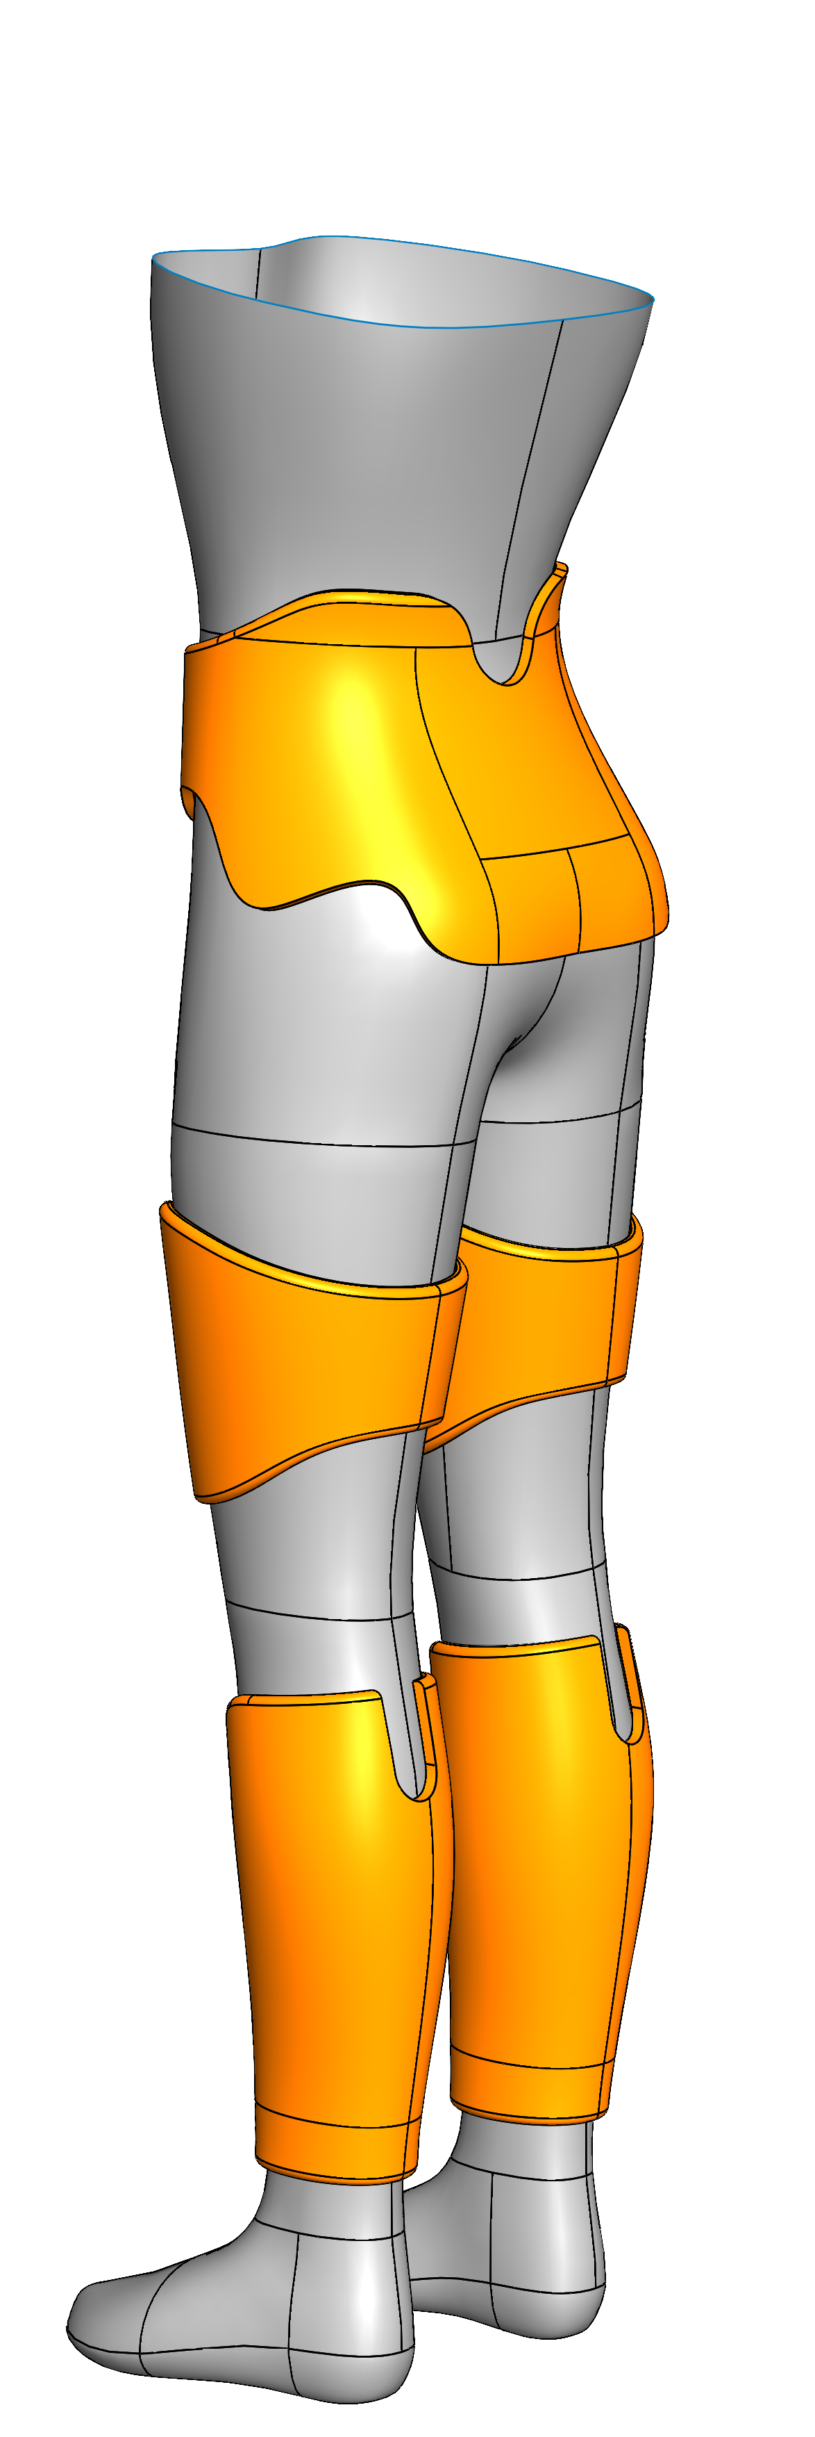
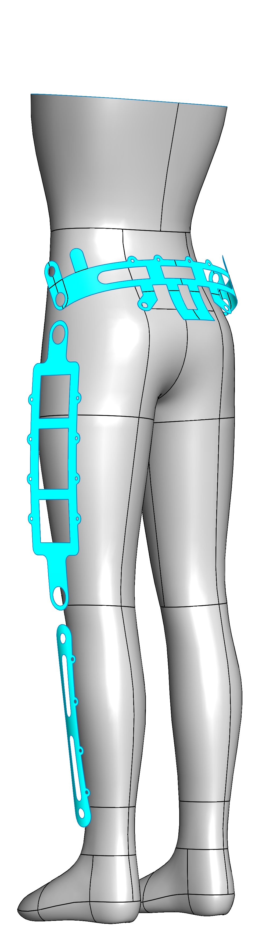

apply thicken feature
apply cut-extrude + fillets
mirror components
duplicate base surfaces
prepare profile sketches
deploy profile sketches
to trim surfaces
duplicate ergo-ref-surface
prepare profile sketches
deploy profile sketches
to trim surfaces
apply thicken feature
mirror components

Slide 8
Q + A’s

